Slide 1



Touch
Typing
Class V
lab 9

Slide 2

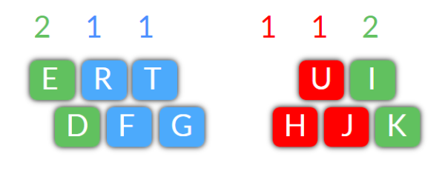
Finger Placement
Notice the two keys G and H in the centre of the keyboard.
Sit so that these are in front of the centre of your body. Use fingers as shown

Slide 3
Left Hand
fg fg fg fgf fgt fg ft ft ft dfg dfgt dft dft
frt frt frt frtg frtg frtg fgt fgt fgt
dfrt dfrt dfrt dfrt dert dert dert dert

Slide 4
Right Hand
jhj jhj jhj jhj jujhj jujhj jujhj jujhj hijk hujk hijk hujk
jhjkik jhjkik jhjkik kikjuj kikjuj kikjuj jujkik jujkik
jhik jhik jhik jihk jihk jihi jihi jihi kih kih kih huhi huhi

Slide 5
Both Hands
grit gritted thrift drift thru true fudge trig trigger hike trike kite true truth
dirt diet tire tired retire retired tried he her here the thee these there their

Slide 6


